Slide 1


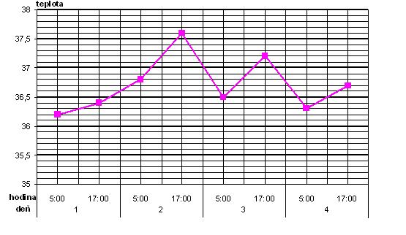
Are (bio)physical knowledge necessary for nurses? (Selected results of written test)
Zuzana Balazsiova, RNDr., PhD.
Faculty of Medicine, Comenius University, Bratislava, Slovak Republic zuzana.balazsiova@fmed.uniba.sk
Introduction
The Biophysics is a teaching subject belonging to basic sciences in theoretical teaching and professional training nurses acting in general care, according Council Directive EEC. (EEC 77/453) It is part of the teaching base for other preclinical and clinical nursing teaching subjects. (Kráľová, E. et al., 2007)
Many students do not appreciate its importance and the reasons for its implementation into the curriculum.
I.Results for descriptive statistics – correct answers
Number of respondents | Average | Standard deviation | Variance | Coefficient of variation | Mode | Median | Max | Min
266 | 6.71 | 1.59 | 2.53 | 0.24 | 6.00 | 7.00 | 11.00 | 0.00
Aim and Objectivities
to determinate technological and physical literacy of nurses
Determination the level of physical knowledge that is need in nursing
Evaluation and analyse of original written test
II.Some results of qualitative analysis
Question 1. Two identical medicine bottles contains 95 ml of solvent and 5 ml of drug (active substance). Water is solvent in bottle No 1 and spirit is solvent in bottle No 2. Both bottles are closed by a standard dropper. Which rule is used for dosing?
a) medicines in both bottles should be dosed with identical drop number
b) the medicines in bottles No1 and No 2 may be dosed differently. (correct answer)
c) the medicine dosage depends only on the kind of dropper.
Respondents and Methodology
266 nurses – part-time students of the 1st and 2nd year of the study program Nursing at three Slovak universities and colleges.
Test results were processed using descriptive statistics and qualitative analysis
Test: 11 questions were based on nursing practice. (4 – administration of medicine, 5 - monitoring of vital function, 2 - positioning the patient)
The basis for the identification of range of biophysical knowledge for nurses:
  Nursing standards (Kontrova, 2005)
  Nursing techniques, Methodology of Nursing Activities - textbook for universities (Kriškova et al., 2006)
The accepted limit - minimally 60% of correct answers.
Question 3. When measuring blood pressure in general, the following applies:
a) The patient has a larger circumference of the shoulder, so a wider cuff should be used (correct answer)
b) the patient has a larger circumference of the shoulder, so a narrower cuff should be used
c) the measurement result does not depend on the width of the cuff
Question 2. In the picture, to find out difference between maximal and minimal body temperature of patient during the 2nd day of hospitalization.
ºC
Conclusion
Nurses have poor knowledge of physics, theory of measurement and devices used in nursing practice.
They do not know to use their knowledge for solving model problem task.
Limitation
Part-time students - the burden associated with employment and family
Didactic methods and forms of teaching
A small number of questions
^{hour}
^{day}
Number of responses to the question No. 2 in percentage
Acknowledgement
Contribution was supported by GP KEGA Ministry of Education, Science, Research and Sport of the Slovak Republic No 026UK-4/2017.
All correct | Incorrect value | Incorrect phys.unit | All incorrect | Incomplet graphic method | not answer
31.2 % | 30.83 % | 3.01 % | 13.53 % | 4.52 % | 16.92 %
  References: Balázsiová, Z. (2012) Koncepcia výučby biofyziky v bakalárskom študijnom programe Ošetrovateľstvo. [The conception of teaching biophysics in the Nursing Bachelor´s degree program]. Dissertation work. Jessenius Faculty of Medcine in Martin, Comenius University, Bratislava, 180 p.
  KONTROVÁ, Ľ. et al. (2005) Štandardy v ošetrovateľstve. [The Nursing standards] Martin: Osveta. ISBN 80-8063-198-0
Kráľová, E. et al. (2007). Biomedicínske predmety v curricule študijného programu ošetrovateľstvo. [Biomedical subjects in curriculum of nursing study program ] In: Čáp, J. a Žiaková, K. (eds.) Ošetrovateľstvo, teória, výskum a vzdelávanie. Zborník [CD-ROM]. Martin: JLF UK,, p.221-226. ISBN 978-80-88866-43-5
KRIŠKOVÁ, A. et al.(2006) Ošetřovatelské techniky. Metodika sesterských činností. [The Nursing Techniques, Methodology of Nursing Activities] Martin: Osveta. 780 s. ISBN 80-8063-202-2
Council Directive 77/453/EEC of 27 June 1977 concerning the coordination of provisions laid down by Law, Regulation or Administrative Action in respect of the activities of nurses responsible for general care. Official Journal L 176 [online] 1977, p. 8-10 [Accessed 2017-07-17]. At http://eur-lex.europa.eu/LexUriServ/LexUriServ.do?uri=CELEX:31977L0453:EN:HTML.

