Slide 1
Comenius University, Faculty of Medicine in Bratislava, Slovak Republic
Factors affecting the effectiveness of teaching biophysics in the bachelor nursing study program
(based on original statements by teachers and students)
Zuzana Balázsiová
Montreal, 2018

Slide 2
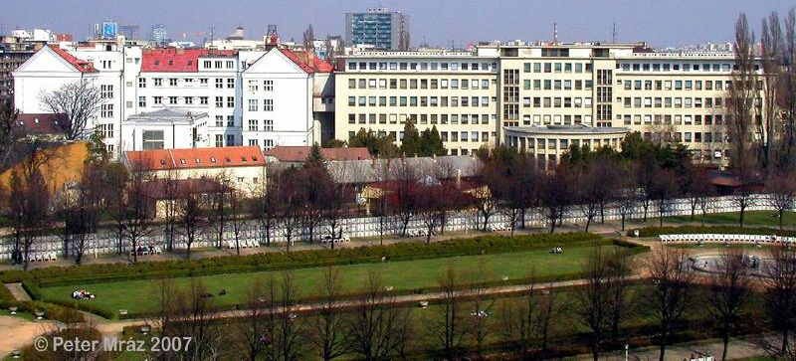


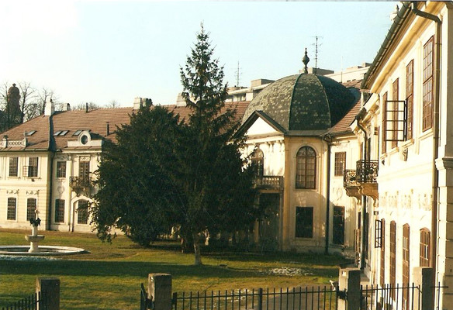

Slide 3
The Position of Biophysics in the Nursing Study Program
General attitude: „It is an unnecessary compulsory subject, you will never need it!“
Biophysics
The basis for study
Techniques of Nursing Procedures
All procedures of the nurse in relation to the patient
Preclinical Subjects
Biochemistry, Physiology, Radiology, Pharmacology, Pathological Physiology
Clinical Subjects
All of them

Slide 4
The Goal of Study
to identify factors affecting the effectiveness of teaching biophysics in Nursing study program
Background
  Dissertation + Results of previous research (published)
  My experience from teaching biophysics in Medical Faculty
  Parental experience

Slide 5
Background – Results of Previous Research
Students cannot solve simple model tasks focused on nursing after completion of biophysics.
  Written test = 1 open question + 1 reading from the chart + 9 closed question (choice 1 correct answer). The success rate – at least 60% of the correct answer
Number of students | Study program | Mode of study | Average success rate
266 | Nursing | Part-time | (61.00±14.45) %
199 | Urgent Health Care | Full-time | (57.63±17.55) %
271 | General Medicine; Dentistry | Full-time | (61.36±19.73)%

Slide 6
Examples of test questions (Test and results were published in J Nur Healthcare, Vol 3, Issue 1, 2017 pp3-4)
1. Two bottles of equal size contain 95 ml of solvent and 5 ml of the medicament-active substance. Bottle I. has water as a solvent and bottle II. has alcohol. Both bottles have a standard dropping closure. What rules apply to dosage?
a) The same number drops are needed from bottle I. and bottle II. for a dose of the medicament
b) A different number of drops may be needed from bottle I. and bottle II. for a dose of the medicament
c) The dosage depends on the type of dropping closure
2. When measuring blood pressure, a general principle is:
a) The larger the circumference of a patient’s shoulder, the wider a cuff should be
b) The larger the circumference of a patient’s shoulder, the narrower a cuff should be
c) The result of measurement is not affected by the width of the cuff

Slide 7
Background – Pedagogical and Parental Experiences
Students' statements:
"... I am studying a health program because my logical thinking is low ..."
"... the block we have from high school (against physics) cannot remove even the best professor ..."
"... I could not prepare for practical exercise (in biophysics); I had to work at McDonald's. I need money, parents do not have them ..."
Parental experience (Physics at grammar school) - application of an individual approach
in teaching???
Physics is extremely simplified - physical nature disappeared
Excessive use of mathematical expressions - physical nature disappeared
Explanation of misunderstood content of a taught topic...“I look and see“...

Slide 8
Effectiveness of Biophysics teaching at Universities
Requirements for university studies:
  Managing a large volume of knowledge in a very short time – the need for highly effective teaching
Other factors
teacher
student
Accepting teacher - student feedback!!!
Effectiveness of teaching = quality and durability of students´ knowledge

Slide 9
Effectiveness of Biophysics teaching and student personality
Students' statements:„...It is an unnecessary compulsory subject, you will never need it!...“
(UN)MOTIVation of Student in relation to physics – general attitude to physics, general ignorance of the relationship between biology and physics, prioritizing a more important subject (anatomy) at the expense of biophysics
Students' statements: "... I am studying a health program because my logical thinking is low ..."
"... the block we have from secondary school (against physics) cannot remove even the best professor ..."
student self-confidence (LOW) – Physical knowledge are “enveloped“ by mathematics.

Slide 10

Effectiveness of Biophysics teaching and student personality
Students' statements: "... I could not prepare for practical exercise (in biophysics); I had to work at McDonald's. I need money, parents do not have them ... "
ORGANIZATION OF THE STUDENT´S OWN TIME – work at the last minute, (overwriting, copying, plagiarism, school cheating ), reliance on short-term memory, exhaustion
BEHAVIOUR, MOMENTARY OR LONG-TERM DISPOSITION OF STUDENT– health condition, personal problems of the student - attention, gaps in acquired knowledge, cumulating of errors.
Retrieved from: http://eduscapes.com/instruction/images/wikipedia.jpg

Slide 11
Effectiveness of Biophysics teaching and teacher personality
Teachers' statements: “... I look and see...“
Explanation „teacher monologue“ - monotonous, inappropriate activities and tempo, an inadequate form of explanation
Teachers' statements:"... but that's the topic of the elementary school, learn it!"
„... the teacher is always right...“
behaviour – autocratic approach, humiliating and ridiculing their students, inappropriate amount of homework
examination – requires too abstract knowledge, tricks in questions, keeps the atmosphere of fear

Slide 12
Effectiveness of Biophysics teaching and teacher personality
failing lesson plan – teacher is not fast enough to teaching planned lesson, to measure the practical exercises
MOMENTARY DISPOSITION OF TEACHER – health condition, personal problems...

Slide 13
Effectiveness of Biophysics teaching and other factors (teacher has not influence on it)
Level of secondary school knowledge of students – high variability in knowledge, lack of knowledge in most cases, the lack of students´ skills in searching for the required information on internet
PREREQUISITES FOR PASSING OTHER SUBJECTS – promoting the position of biophysics in health science systems – insufficient, missing
PedagogicAL EDUCATION OF TEACHERS – insufficient, missing
Science teacher´s professional knowledge – lack of knowledge of the relationship between nursing practice and physics, the use of physics in nursing

Slide 14

Effectiveness of Biophysics teaching and other factors (teacher has not influence on it)
Teachers' statements: “...I give students to write in the report of measurement (from biophysical practical exercises) everything what they usually do not know on the exam...“
Incorrect output establishment of Biophysical practical exercises – very large outputs with a lot of maths, plagiarism – problematic checking and evaluation of protocols
Retrieved from: http://www.academycollegecoaches.com/wp-content/uploads/2017/04/App-Stress-1080x675.jpg

Slide 15
Recommendation for increasing effectivity of Biophysics teaching
Pedagogical education for university teachers: learning „HOW TO TEACH“
Individual approach to students
Vertical and horizontal articulation (of the curriculum ) related to biophysics
Soberly assess the extent of homework: „less is sometime more“
Accept feedback teacher – student – teaching must not be anonymous
CONTENT AND FORMS OF TEACHING
  Seminars and practical exercises supplement lectures on Biophysics
  Teaching to focus on techniques of nursing procedures
  To teach more topics in the field of handling of instrumentation used in nursing

Slide 16
Recommendation for increasing effectivity of Biophysics teaching
TEACHING METHODS
  Eliminate of the mathematics – physics without maths
  Proceed from nursing (procedure) to physical (phenomenon)
  Use modern teaching methods that support thinking of students and their searching of context (problem solving teaching, brainstorming...)
  Consolidation of knowledge: e-learning, projects
  Explain of new knowledge: blended learning, e-learning (use only for non-problematic topics, keep principle of the small steps)
  Project Based Learning- topic focused on problem solving, emphasize the last phase – final project defence

Slide 17
  From nursing (procedures) to physical (phenomenon)
Administration of medicine
drops
Dosing of the medicines to the patient (drop size)
Surface tension
Infusion, injection
Administration to patient
(injection sites)
Tonicity of solutions
(Bio)PHYSICS
NURSING

Slide 18
Conclusion
Theoretical ideal status
Ideal teacher + ideal student + ideal other factors = maximum effective teaching (permanent biophysical knowledge with maximum use in nursing practice)
Real status
Real teacher + real student + real other factors + take a few presented proposals = a possible increase in the effectiveness of the teaching of biophysics in nursing

Slide 19
Thank you for your attention

