Slide 1
Comenius University, Faculty of Medicine in Bratislava¹ in cooperation with
Constantine the Philosopher University, Faculty of Social Sciences and Health Care in Nitra², Slovak Republic
Analysis of the level of biophysical knowledge of Urgent Healthcare students
Zuzana Balázsiová¹, Monika Mankovecká²
Tokyo, 2018

Slide 2

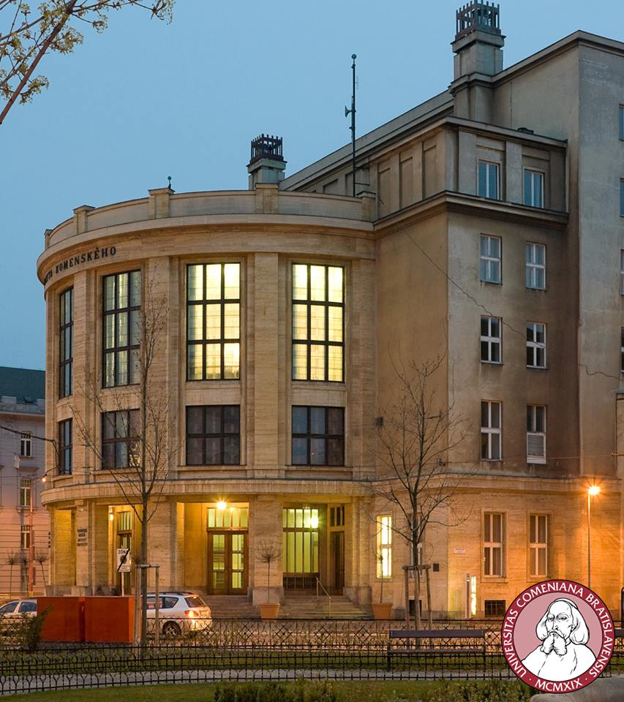
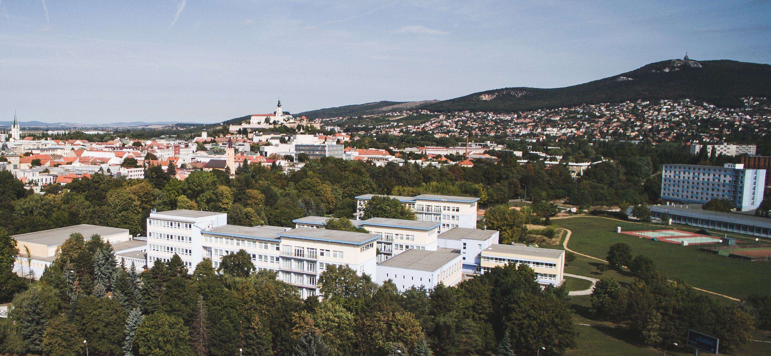

https://www.worldatlas.com/img/areamap/8f13d3140fe41530dd5ede39ffe09274.gif
https://zona.fmed.uniba.sk/uploads/pics/UK_photo_1_01.jpg
http://www.agrobiotech.sk/wp-content/uploads/2015/11/DJI_0053.jpg

Slide 3
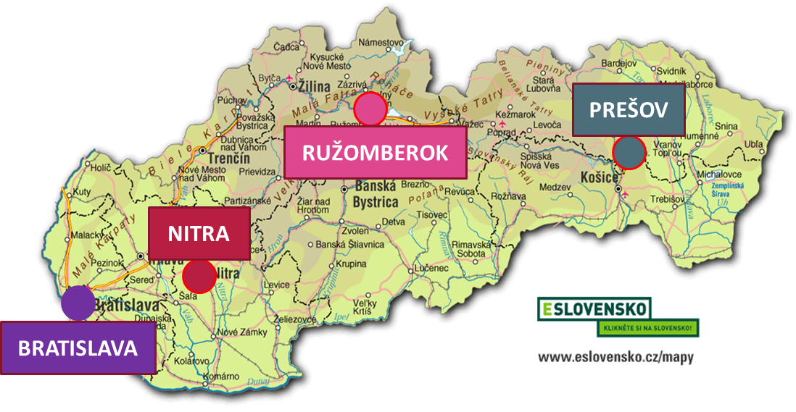
Study of Urgent Healthcare in Slovakia
4 universities
Bachelor study program
  Full-time study (3 years)
  Part-time study (4 years)
The problem:
There are no official standards for procedures in urgent healthcare.
https://slovensko-chat.webnode.cz/_files/200000036-f1b85f2af7/slovensko-komplet-big.gif

Slide 4
Teaching of Biophysics in Urgent Healthcare study program in Slovakia
The 1st semester, together with radiology or/and biochemistry
Form of teaching: lecture, self-study
Direct teaching: 12-26 lessons
Completion of the course: continuous assessment, exam, 2-3 credits

Slide 5
Biophysics in Urgent Healthcare study program
Biophysics
The basis for study
Techiques of Nursing procedures
Selected procedures of rescue worker to the patient
Preclinical Subjects
Biochemistry, Physiology, Radiology, Pharmacology, Pathological physiology
Clinical Subjects
All of them
Urgent Healthcare
All procedures of rescue worker to the patient

Slide 6
Goal
to determine the level of functional physical literacy of students of bachelor's Urgent Healthcare study program.
Methodology – respondents
RESPONDENTS
Year of study | Full-time study | Part-time study | Excluded tests | sum
1. | 135 | 13 | 3 | 151
2. | 39 | 0 | 0 | 39
sum | 174 | 13 | 3 | 190
190 students from 4 universities
  women: 86
  men: 90
  trans: 1
  not specified: 13
age: (20.55±1.95) years

Slide 7
Methodology – testing (test was published in J Nur Healthcare, Vol 3, Issue 1, 2017 pp. 3-4)
Validation: curriculum in biophysics of all faculties
Focus of tasks: Physics– 9 tasks Healthcare - 11 tasks
8 questions – multiple choice, 1 correct answer from three options
1 question with open-ended response
2 short answer questions -filling number and physical unit
Thematic area | Number of tasks
Detection of vital signs | 5
Administration of medications | 4
Patient positioning | 2
Realisation:
  after completion of biophysics
  anonymous writing without time limit

Slide 8
Methodology – test evaluation
binary score: correct answer – 1 point, incorrect answer – 0 points
the pass mark for the test – 60 % answer correct
Statistical analysis:
descriptive statistics – average, standard deviation
t-test
ANOVA

Slide 9

Results – quantitative analysis of tasks focused on healthcare
Average number of correct answers: (6.32 ± 1.89) = (57.45 ± 17.18) %
standard
PREŠOV
RUŽOMBEROK
NITRA
BRATISLAVA
https://slovensko-chat.webnode.cz/_files/200000036-f1b85f2af7/slovensko-komplet-big.gif

Slide 10
Results – quantitative analysis of tasks focused on healthcare

Slide 11
Results – quantitative analysis of tasks focused on healthcare

Slide 12
Results – quantitative analysis
Thematic area | Total correct answer [%] | Standard at Slovak universities [%]
Detection of vital signs (5 questions) | 35.08 | 60.00
Administration of medications (4 questions) | 59.30
Patient positioning (2 questions) | 81.28

Slide 13
Results – qualitative analysis
 | Detection of vital signs of human Task focused on | Total correct answer [%] | Comparison of faculties (p)
1. | the impact of cuff dimensions on the result of blood pressure measurement | 41 | < .0001
2. | the reason for not hearing during auscultation - to find out the physical cause of the stethoscope malfunction | 23 | < .0001
3. | pulse rate measurement - possible impact of the size of the area formed by the fingers on the measurement result | 62 | 0.0051
4. | determination of pulse rate result - correct calculation and writing of result in correct form | 35 | 0.0001
5. | finding information from the patient's temperature curve - reading from the chart and writing down of result in the correct form | 31 | 0.62

Slide 14
Examples of test questions (Test was published in J Nur Healthcare, Vol 3, Issue 1, 2017 pp.3-4)
1. When measuring blood pressure, a general principle is:
a) The larger the circumference of a patient’s shoulder, the wider a cuff should be
b) The larger the circumference of a patient’s shoulder, the narrower a cuff should be
c) The result of measurement is not affected by the width of the cuff
2. At first sight a stetoscope appears to be a good condition (bell, diaphragm, transfer system) but you do not hear anything on auscultation. Give a reason.
3. A nurse counts 11 pulses on a patient´s cervical artery in 10 second. What is patient´s pulse rate, assuming that they have a regular pulse?

Slide 15
Results – qualitative analysis
 | Administration of medications Task focused on | Total correct answer [%] | Comparison of faculties (p)
1. | reading from calibrated scale and conversion of physical units. | 31 | 0.0066
2. | dosing of generic drugs - surface tension | 53 | < .0001
3. | intravenous drug administration - tonicity of the solution | 80 | 0.060
4. | physical possibilities of influencing the infusion flow | 73 | 0.45

Slide 16
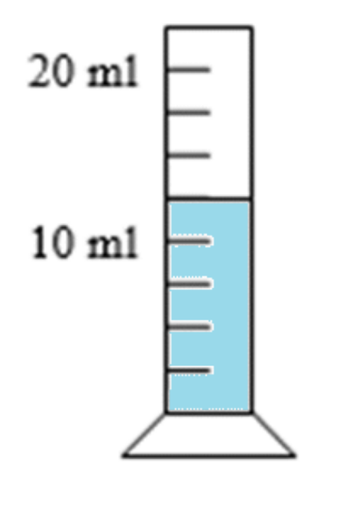
Examples of test questions (Test was published in J Nur Healthcare, Vol 3, Issue 1, 2017 pp.3-4)
1. Two bottles of equal size contain 95 ml of solvent and 5 ml of the medicament-active substance. Bottle I. has water as a solvent and bottle II. has alcohol. Both bottles have a standard dropping closure. What rules apply to dosage?
a) The same number drops are needed from bottle I. and bottle II. for a dose of the medicament
b) A different number of drops may be needed from bottle I. and bottle II. for a dose of the medicament
c) The dosage depends on the type of dropping closure
2. What volume is the volume of the liquid (in dm³) in the measuring cylinder?
0.125 dm³
0.0120 dm³
c) 0.0125 dm³

Slide 17
Results – qualitative analysis
 | Patient positioning Task focused on | Total correct answer [%] | Comparison of faculties (p)
1. | the location of a person´s centre of gravity | 76 | < .0001
2. | using the center of gravity position when handling the patient | 87 | 0.31

Slide 18
Test questions (Test was published in J Nur Healthcare, Vol 3, Issue 1, 2017 pp.3-4)
1. Where is a person’s centre of gravity?
a) outside their body
b) in the vicinity of the chest
c) in the vicinity of the pelvis and the abdomen
2. After an operation on their appendix, it is easier for a patient to get out of bed if they start on their
a) stomach
b) back
c) side

Slide 19
Summary
Ability of Urgent Healthcare students to solve model tasks focused on practice in healthcare is less than 60%.
  the worst result - detection of vital sign of human
  the best result – patient positioning (small number of tasks!)

Slide 20
Conclusion and recommendation for Biophysics teaching
Content and forms of teaching
Teaching biophysics as a individual subject, increasing the number of lessons.
Add lectures on Biophysics through seminars and practical exercises.
Teaching focus on the applications of (bio)physics in medicine and health sciences. (Usually this is not fulfilled if the biophysics is taught by teachers from the Faculty of Natural Sciences or Mathematics and Physics).

Slide 21
Conclusion and recommendation for Biophysics teaching
TEACHING METHODS
  Eliminate of the mathematics – physics without maths.
  Proceed from healthcare (procedure) to physical (phenomenon).
  Use modern teaching methods that support thinking of students and their searching of context (problem solving teaching, brainstorming...)
  Consolidation of knowledge – e-learning, projects.
  Explain of new knowledge – blended learning, e-learning (use only for non-problematic topics, keep principle of the small steps).
  Project Based Learning – topic focused on problem solving, emphasize the last phase – final project defence.
Notes:
I

Slide 22
  From health care (procedures) to physical (phenomenon)
Administration of medicine
Drops
Dosing of the medicines to the patient (drop size)
Surface tension
Infusion, injection
Administration to patient
(injection sites)
Tonicity of solutions
(Bio)PHYSICS
Health care

Slide 23
Thank you for your attention

