Slide 1
Heart murmurs

Slide 2
Propedeutics
Patophysiology –> turbulent blood flow
Characteristics
Systolic/diastolic/continuous
Punctum maximum
Intensity (1-6 Levine scale)
Propagation (direction of blood flow)
Thrill (yes/no)

Slide 3
Murmur types that are clinically relevant
Structural heart disease (<1% children)
Innocent heart murmur (50% children)
Left ventricular tendon (10% children)
-> ECHO

Slide 4
Structural heart disease (<1% children)
Congenital heart disease (VSD, PDA, CoA,...)
Hypertrophic cardiomyopathy with obstruction
Heart tumor
Endocarditis

Slide 5
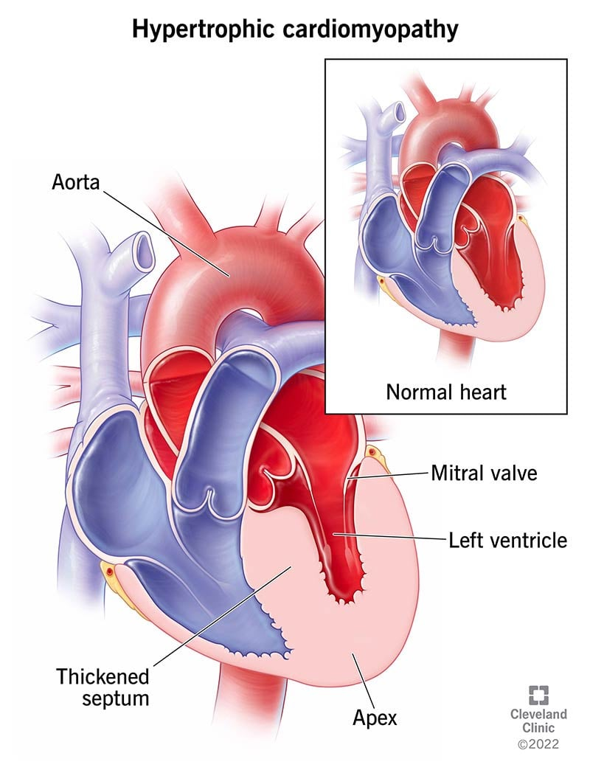
https://my.clevelandclinic.org

Slide 6
Innocent murmur (50% children)
Other names: functional murmur, benign murmur
Normal ECHO = healthy person
Characteristics
Low intensity (1-3)
Systolic
Changes according to body stance
Disappears after puberty
Normal ECHO

Slide 7
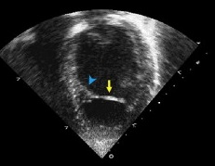
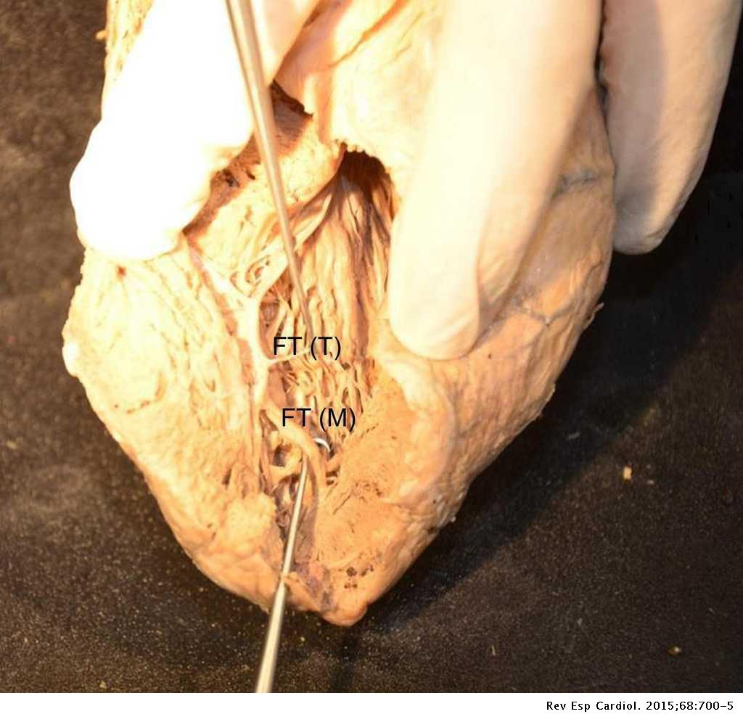
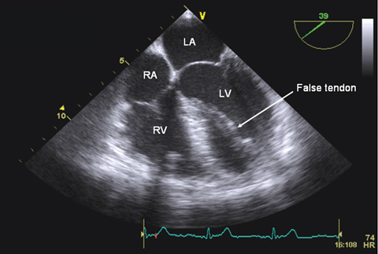
Left ventricular (false)tendon (10% children)
Benign ECHO diagnosis = healthy person
https://doi.org/10.1016/j.echo.2013.03.005
Med J Aust 2007; 187 (10): 591. || doi: 10.5694/j.1326-5377.2007.tb01426.x

