Slide 1

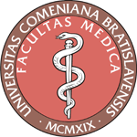
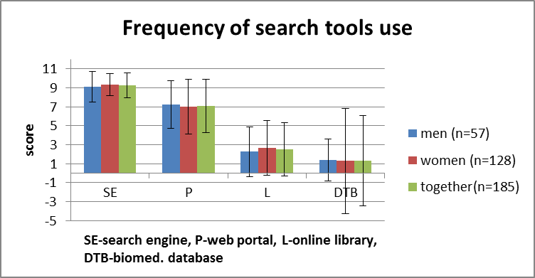
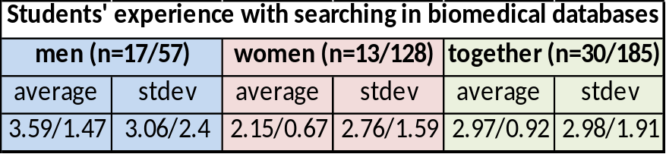
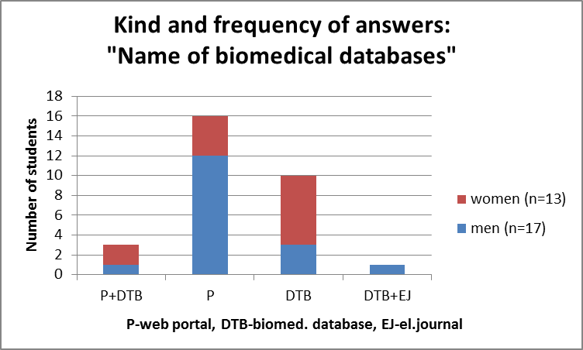
Subjective assessment of students' ability to use ICT during the 1st year of the medicine study
Balazsiova, Z., Kralova, E.
Comenius University, Faculty of Medicine , Institute of Medical Physics, Biophysics, Informatics and Telemedicine , Bratislava , Slovak Republic
Research question: How are the 1st year students prepared to use ICT in studies of medicine?
Summary of work: The questionnaire topics: 1. Using search tools on the Internet by students. 2. How students are informed about biomedical databases. The assessment score (0 – doesn´t know, doesn´t used 10 - the mostly used, expert).
Conclusions: The students have usually problem to acquire information, which is needed for their study. Their experience in the use of scientific databases and libraries are minimal and inadequate.
Take-home message: The 1st year medical students could learn searching relevant and current medical scientific sources in professional medical databases and libraries for the purposes of their study in the introductory course.
This study was supported by KEGA MŠVVaŠ SR 052UK-4/2013

